Slide 1

Watson Assistant 101
Labs Gary Wilson CTO & Technical Leader, UKI Commercial Business

Slide 2
Objective
Create a basic chatbot to help guide you when buying a new mobile phone / contract
IBM Cloud
Watson Assistant

Slide 3
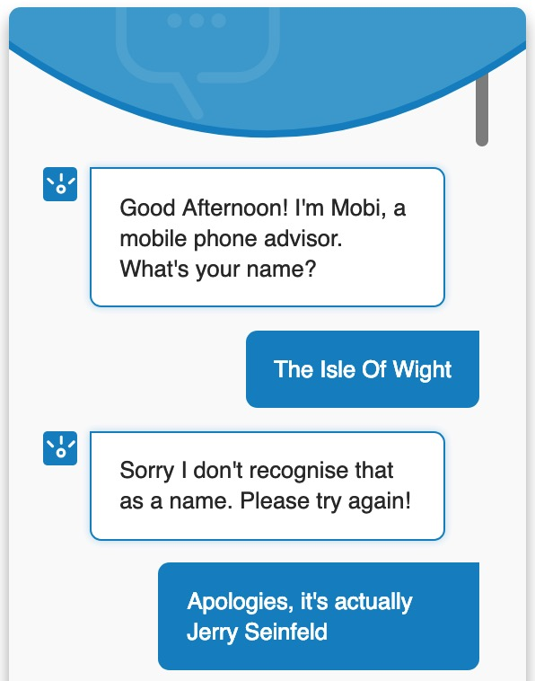
Your Chatbot!
1 – greet user
2 – check for valid name

Slide 4
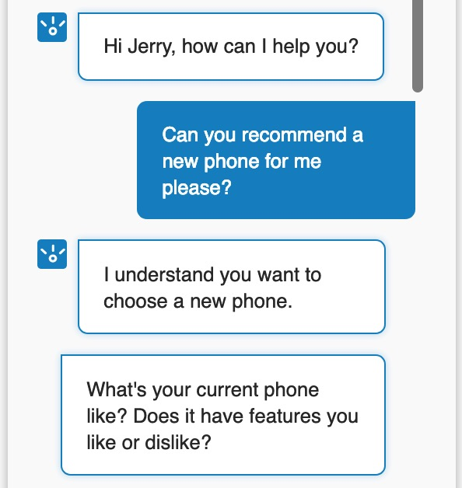
Your Chatbot!
3 – personalise / shorten name
4 – understand user intent
(phone recommendation)
5 – ask qualifying question

Slide 5
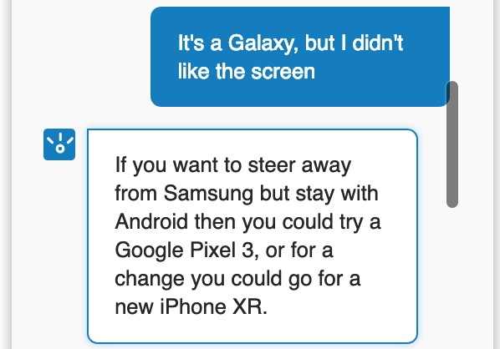
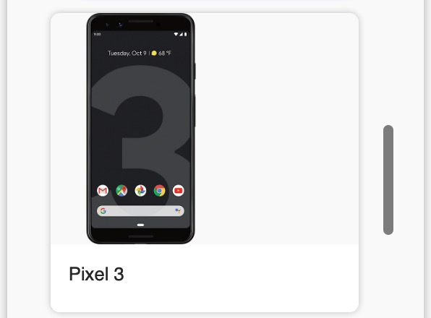
Your Chatbot!
6 – understand user sentiment
and recommend alternative
7 – enhance user experience
using images

Slide 6
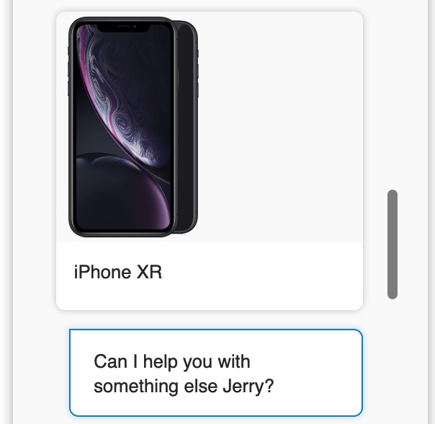
Your Chatbot!
8 – reuse name

Slide 7
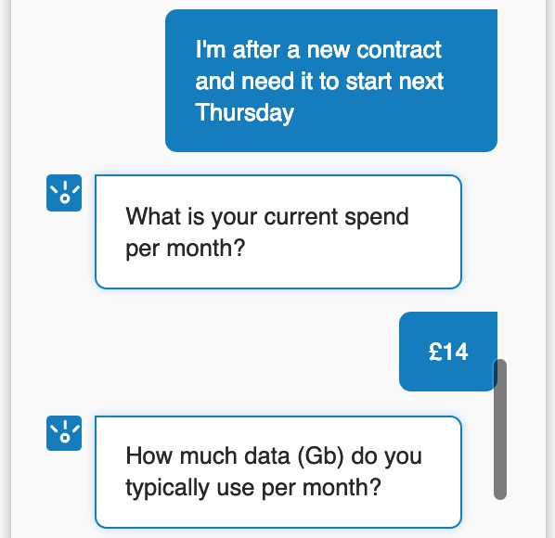
Your Chatbot!
9 – understand user intent
(contract recommendation)
10 – gather multiple pieces of
data to customise response

Slide 8
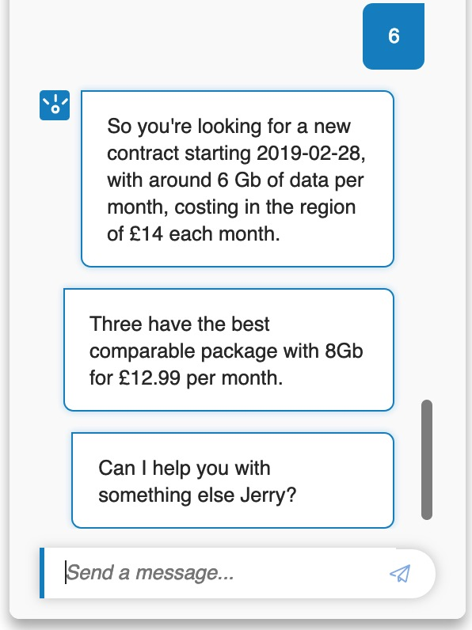
Your Chatbot!
11 – confirm user data
12 – provide contract
recommendation

Slide 9
What is Watson Assistant?
Combines:
machine learning
natural language understanding
integrated dialog tools
… to create conversation flows between your apps and your users
Basic terms
Skill
a container for all of the artefacts that define a conversation flow
Intent
Entity
Dialog

Slide 10
Intents and Entities
Intents are a purpose or goal expressed by a user’s input
recognise user’s intent => choose the correct response
train Watson Assistant with multiple examples
Entities represent a class of object
can be used to trigger different responses, even for same intent
In our labs:
intents
newphone (‘I want to get a new phone’, ‘I’d like advice on a new mobile’,…)
positive (‘I like my Galaxy’, ‘I love my Google phone’, …)
negative (‘I don’t like my iPhone’, ‘I hate my Pixel 2’, …)
entities
brand (Apple, Samsung, Google, …)
attribute (style, battery, …)

Slide 11
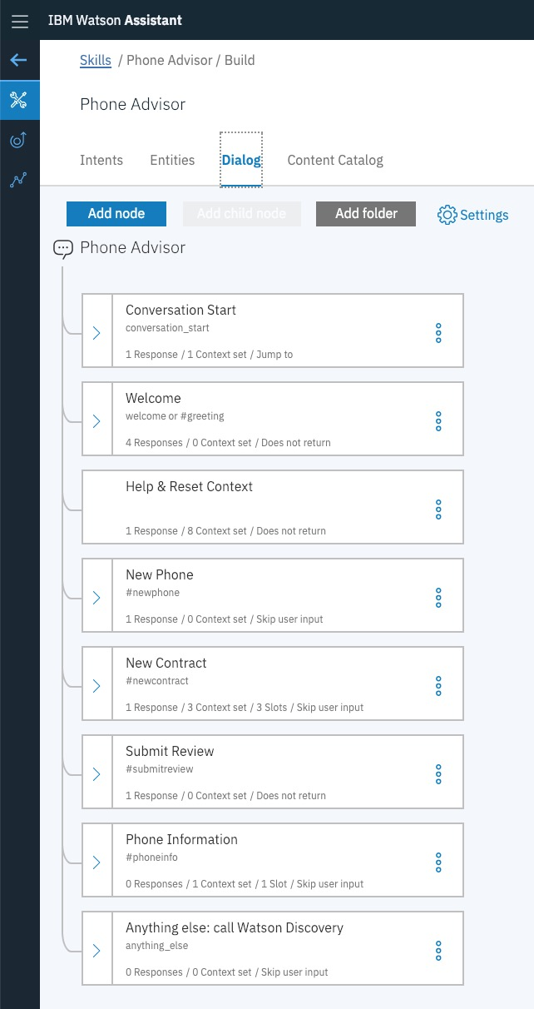
Dialog
Defines the flow of your conversation in the form of a logic tree
Each node of the tree has a condition that triggers it, based on user input
Uses intents and entities
Interacts with the user and provides a response
text, images, options

Slide 12

Agenda
Setup Watson Assistant
Create a skill
Create intents, entities
Create a dialog tree utilising both intents and entities
Test your chatbot
Create a live, web-hosted version of your chatbot

Slide 13
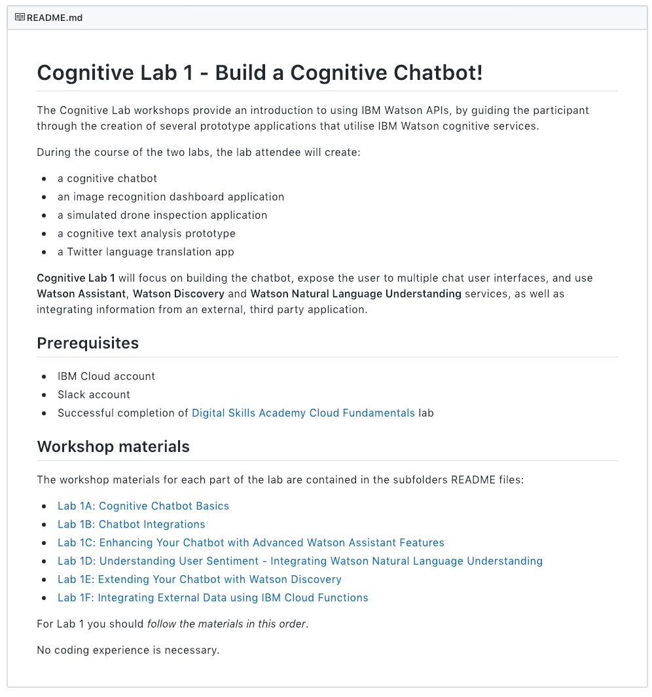
Lab Format
Step-by-step instructions
GitHub README.md for each lab
Work at your own pace
https://github.com/garyrwilson/Watson-Assistant-Labs

Slide 14

Watson Assistant 101
Labs Gary Wilson CTO & Technical Leader, UKI Commercial Business

